Slide 1
Designing a soldering station
Author:
Oliwier Jaworski

Slide 2
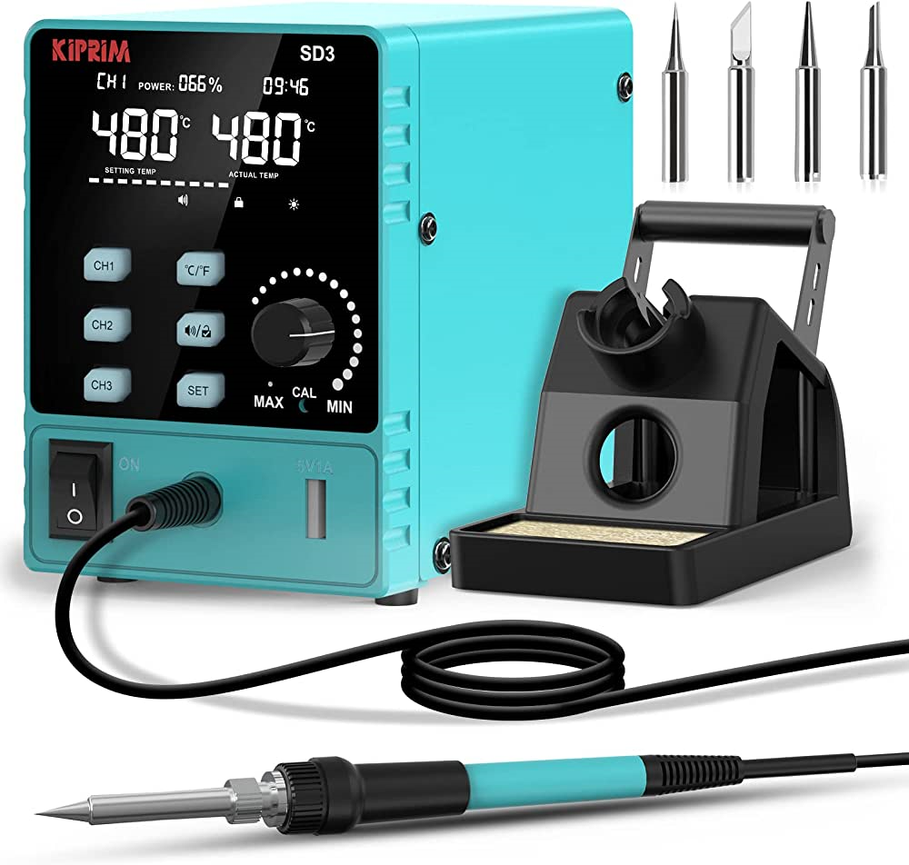
Introduction
Project
Purpose
Goal
Guidance

Slide 3
Materials and methods
Components PCB Case

Slide 4

PCB

Slide 5

Case

Slide 6
Results

Slide 7

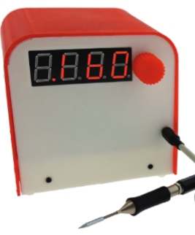
outside
Case
rotary encoder
7 segment-display
Aux port

Slide 8
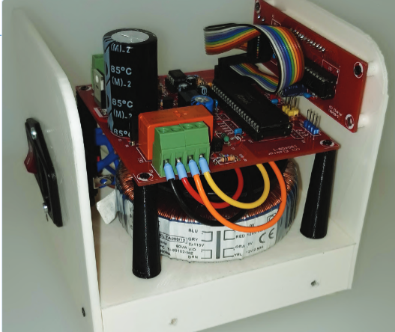
inside
Soldering iron driver
Thermocouple
Microcontroller
Power supply

Slide 9
Discussion
Component challenges
Design issues
Time and cost consideration
Potential improvements

Slide 10
Thank you!
Any questions?

